Slide 1
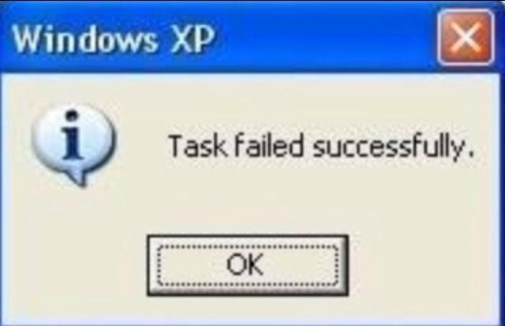

Slide 2
If your programs don’t work well, they’ll be thrown away like that!

Slide 3
So, how do we know if our program is fine?
? ? ? ? ? ? ? ? ? ? ? ?

Slide 4

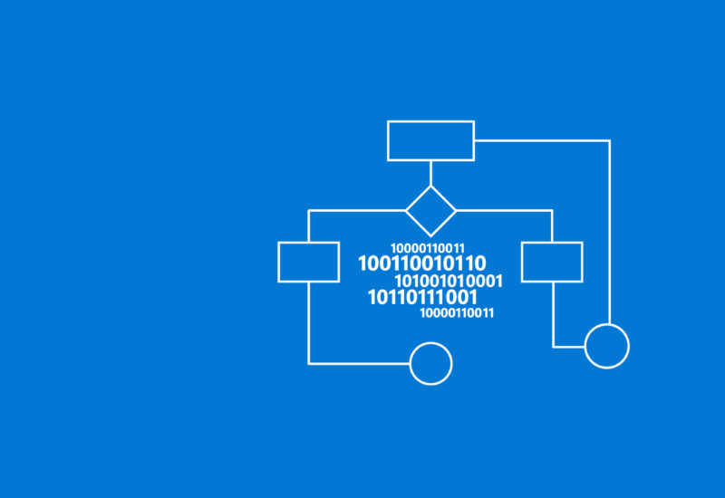

There are many ways to verify the correctness of a program
TESTING
CORRECTNESS PROOF
OR COMBINE THEM! ;)

Slide 5
TESTING Using Test Cases

Slide 6


What is Test Cases?
Test case is a set of data include our INPUTs and attached OUTPUTs.
We use test case to verify that our program return expected results.
INPUTs
OUTPUTs
Expected outputs

Slide 7



How to write Test cases for a program?
Test cases should be saved in text file.
One test case is used for one test purpose.
We start with writing small, simple test cases.
Then we continue with some test cases including special values or abnormal values. Programs often return wrong results because of those kinds of value.
If we understand how our code work, just write some test cases for “corner” cases.
- We also need some big test cases to check the program’s ability.

Slide 8
Basic format of test case
Test ID: such as “input1.txt” – “output1.txt”, “001.txt” (in input folder) – “001.txt” (in output folder).
Test data: we save input data in input files and expected output in output files.
Divide test cases into independent folder, remember, One test case is used for One purpose.
Don’t forget to describe what to be verified for test cases.

Slide 9
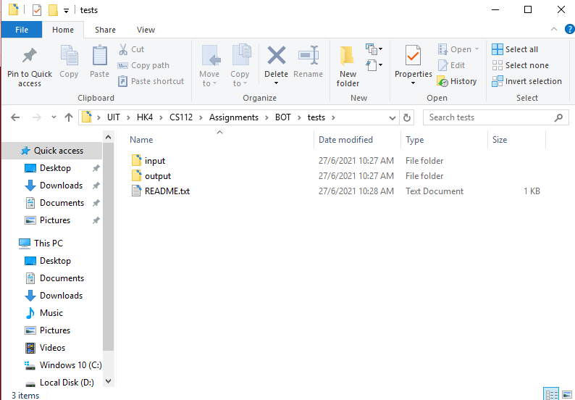
Example: write test cases for BOT program and execute test by Python
- Create “tests” folder including “input” and “output”.

Slide 10
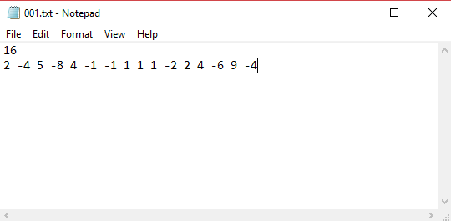
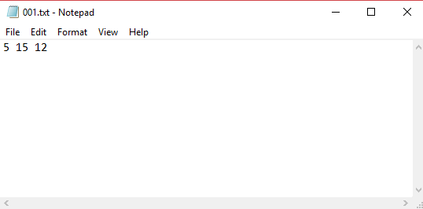
Example: write test cases for BOT program and execute test by Python
Write test data:
INPUT EXPECTED OUTPUT
Save in “input” folder as “001.txt” Save in “output” folder as “001.txt”

Slide 11
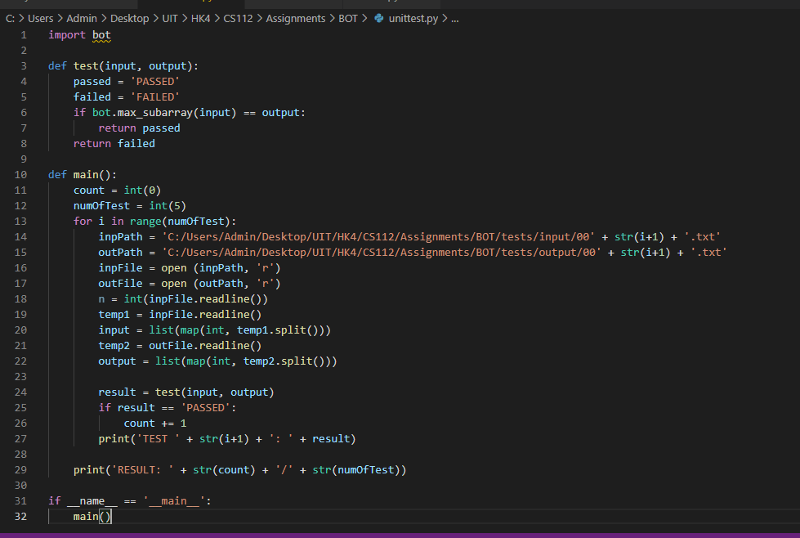
Example: write test cases for BOT program and execute test by Python
- Create simple test runner:

Slide 12
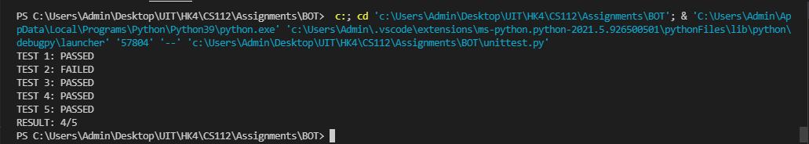
Example: write test cases for BOT program and execute test by Python
- RESULT:

Slide 13
We can use unittest in Python!
A unit test is a smaller test, one that checks that a single component operates in the right way. A unit test helps you to isolate what is broken in your application and fix it faster.
unittest has been built into the Python standard library since version 2.1. You’ll probably see it in commercial Python applications and open-source projects.
unittest contains both a testing framework and a test runner.
For more information: unittest — Unit testing framework — Python 3.9.5 documentation

Slide 14
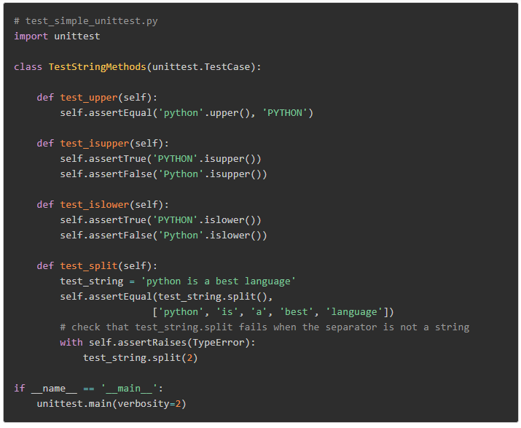
Run test cases using UnitTest in Python

Slide 15
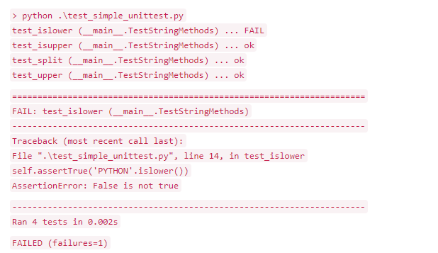
Run test cases using UnitTest in Python

Slide 16
Thank you! <3

